Slide 1

HCL Commerce
Mobile Checkout – Barcode Scanning
Proof of Concept (v9)
April 6th, 2020

Slide 2
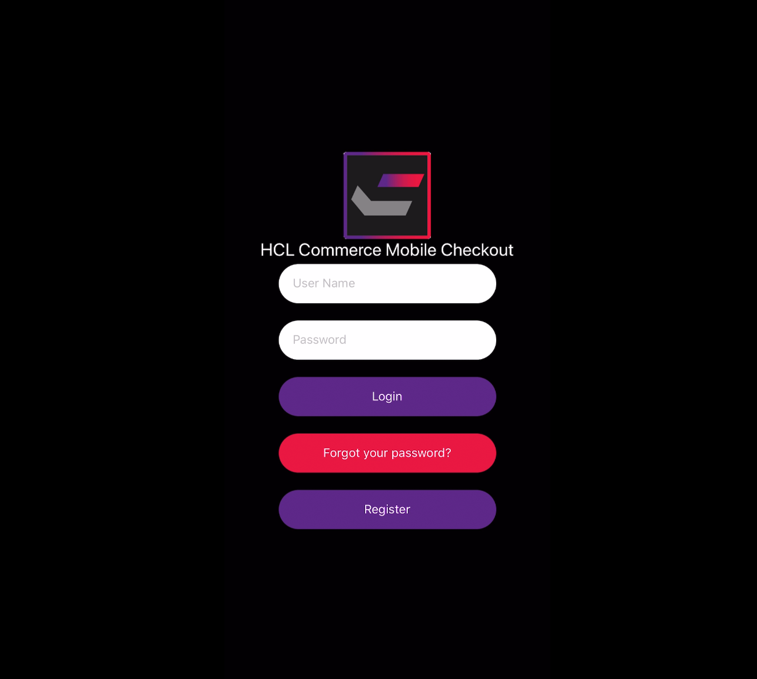
Shop and Go with Mobile Check Out
Barcode Scanner Application,
Proof of Concept

Slide 3
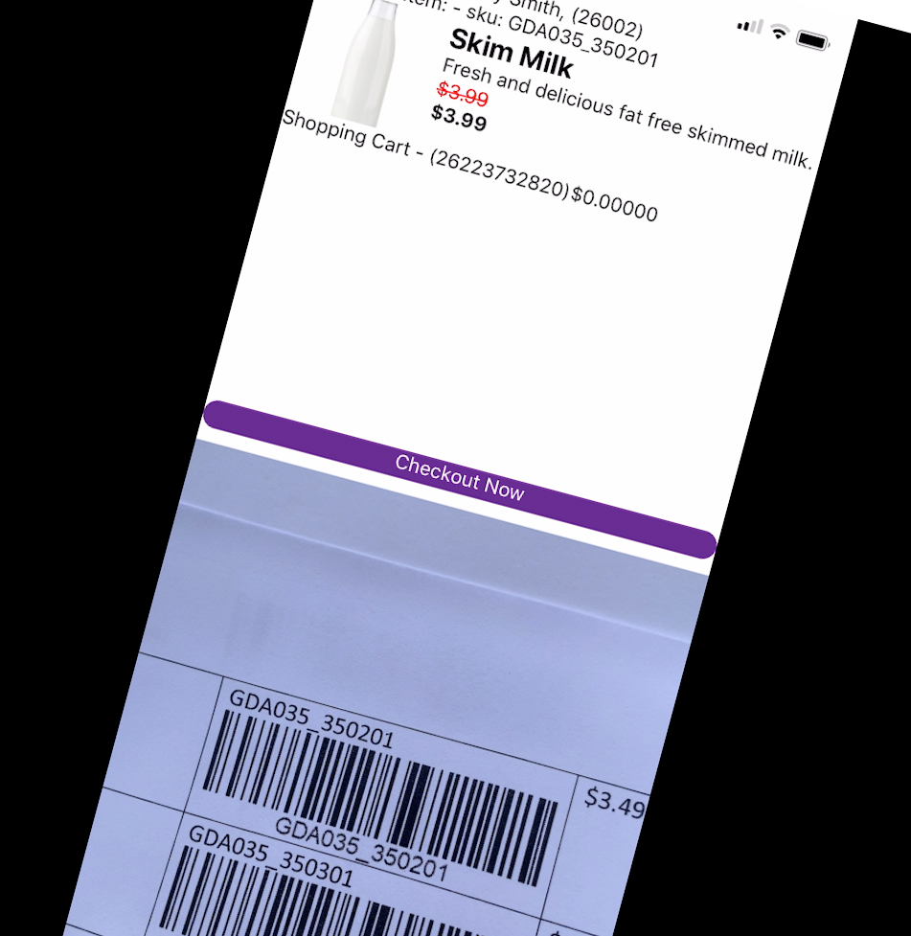
Use Cases
Enable Customers to Self checkout with Mobile Application
Add scanned products to shopping cart
Shopping
Add / Remove Items from Cart
Checkout
Checkout with Preferred Payments
Checkout with Cash/Charge

Slide 4




Prerequisite Technologies
React Native
Node.js
Expo
HCL Commerce v9 REST APIs
“Detailed Step By Step” Documentation

Slide 5
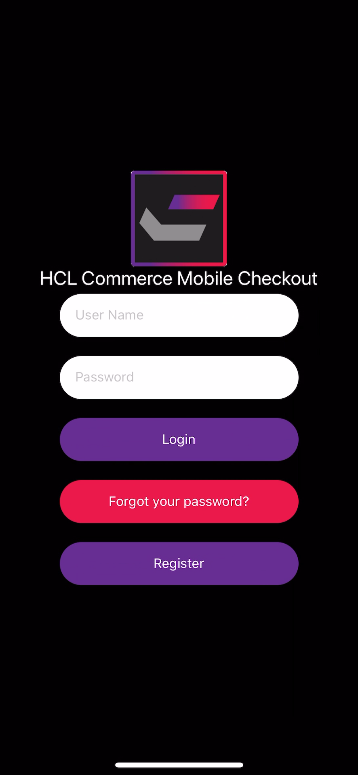
Shop and Go, Proof of Concept
Scan Barcodes and Add to Cart
Checkout
QR Code linked to the Prepared Order
Pay with Saved Payment (Payment Wallet)
Hand-Off Pay at Register

Slide 6
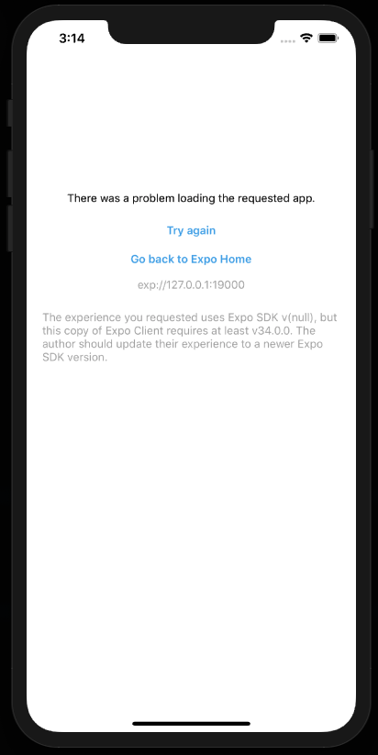
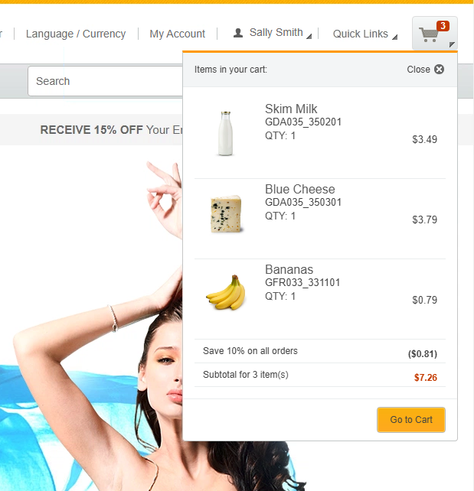
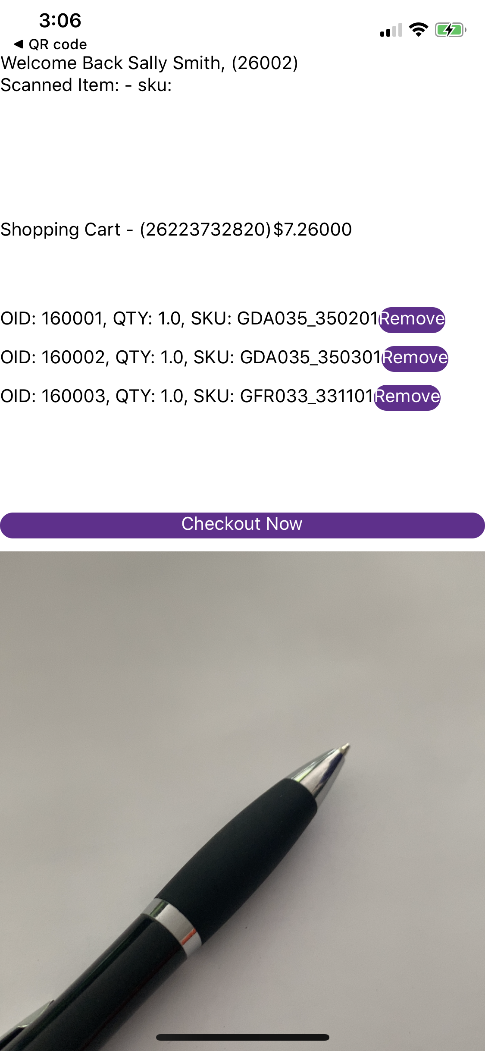
One Scalable Multi-Store Platform
Application Capabilities
Location Services – Select a Physical Store
Store Locator & Pricing
Shared Cart and Shopping Capability
We enabled multi sessions per user to demonstrate the same carts
Push Notifications ( Notification Messaging Capabilities)
Advertising / Marketing (Geo Fencing)

Slide 7

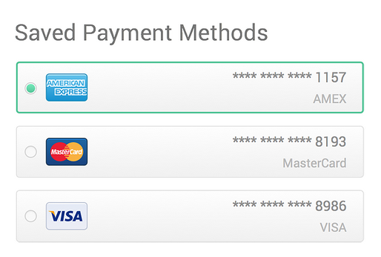
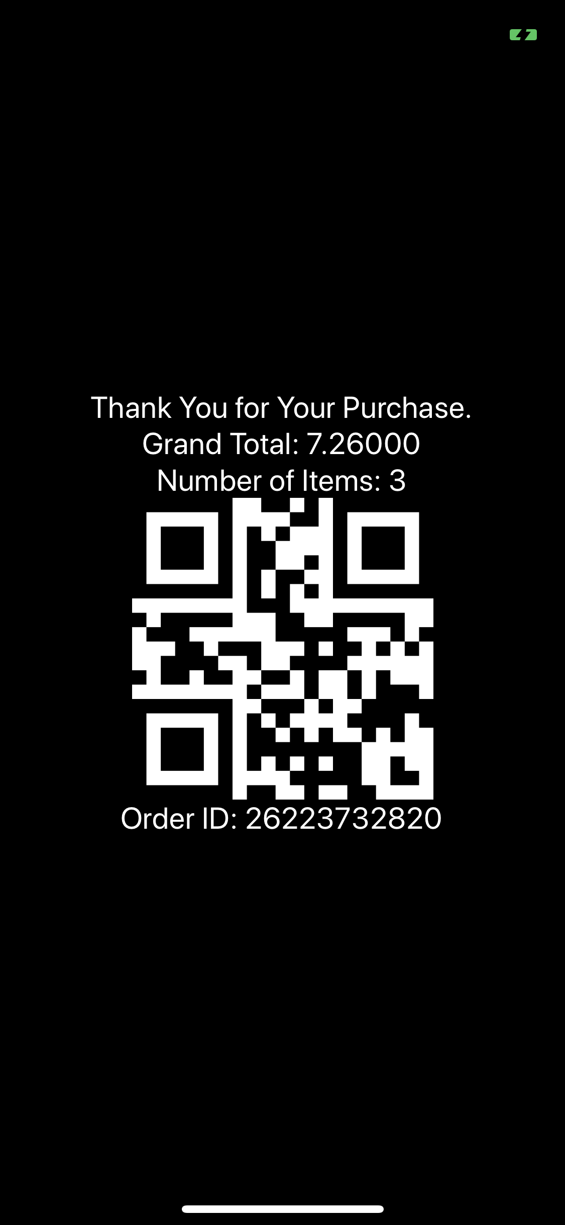
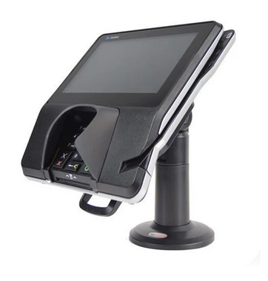
Checkout / Payment
Self-Checkout
Payment
Hand-Off Payment to POS
Pay with a Saved Payment Method
QR Code for Receipt Validation at Door

Slide 8





Other Capabilities w/ React-Native
Push Notifications
Push Sales/Event Notifications
Order is Ready for Pickup
Substitute Requests
Geo Location Services
Store Locator / Shopping Store
Curbside PickUp Services
Home Delivery
Home Delivery – Last Mile (Tracking)

